Slide 1

PROJECT on Data science ON subscription service
By: FANIYI ANUOLUWAPO MARGARET
Ladies Data Science Training (Team Achievers)
May, 2023.
GITHUB REPO LINK : https://github.com/Anumarg/SubscriptionService.git

Slide 2
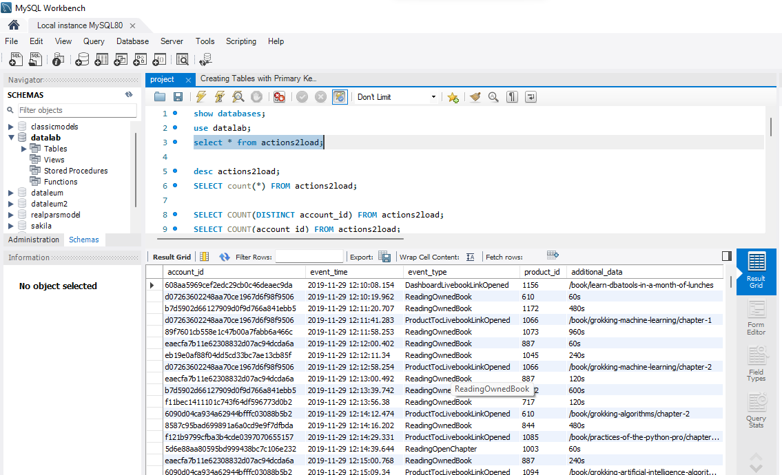
Interface of loading the given data ‘actions2load’ into MYSQL database
MySQL

Slide 3
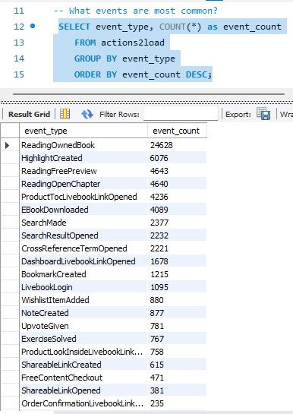
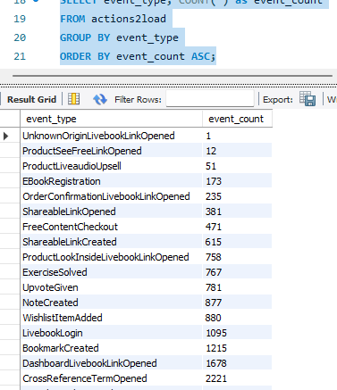
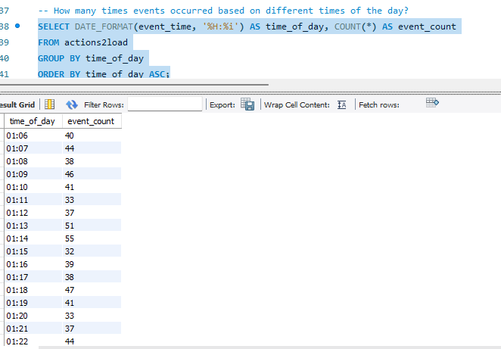
Queries carried out on imported data to answer basic business questions.
MySQL

Slide 4
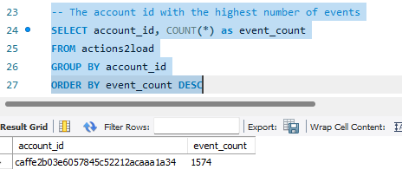
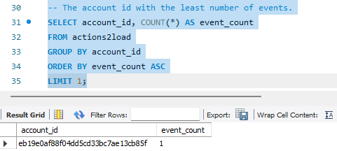
Data querying to answer SQL business questions cont’d.
MySQL

Slide 5
Business Questions Results Summary
S/N | BUSINESS QUESTION | EVENT NAME | FREQUENCY
1. | Most common events | Reading owned book Highlight created Reading free preview | 24,628 6,076 4,643
2. | Least common events | Unknown origin Livebook link opened Product see free link opened Product live audio upsell | 1 12 51
3. | Account Id with highest number of events: | caffe2b03e6057845c52212acaaa1a34 | 1,574
4. | Account Id with the least number of events: | eb19e0af88f04dd5cd33bc7ae13cb85f | 1
5. | Event occurrence based on different times of the day | Varied times of the day | Ranges within 30 – 50 counts

Slide 6
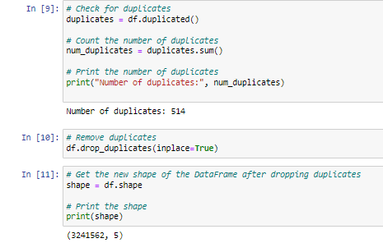
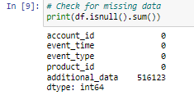
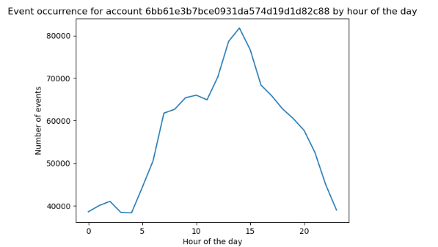
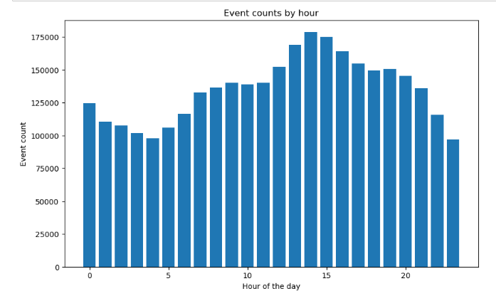
Overview of Data Quality Scrutiny and pattern identification
No of columns = 5
No of rows = 3,242,076
The fifth column (i.e the additional data column) contains some missing data.
Duplicate events discovered = 514
Events occurred unequally at different times of the day. The pattern of event wasn’t constant, but varied within the hours of the day.
The pattern demonstrates that there was steady decline in event count from the 1st to 4th hour, then there was a gradual increase in event count from the 5th to 8th hour; while there was nearly constant increase from the 9th to 11th hour. Meanwhile, there was a sharp increase from the 12th to 14th hour, then steady decline from the 15th to 18th hour, with a negligible increase in the 19th hour, which constantly declined all through the remaining hours of the day.

Slide 7
Insights on a Particular Account I.D 6bb61e3b7bce0931da574d19d1d82c88
Insights gotten from analyzing the account:, depicts that the events occurrence on this account is at the lowest during the very early and late hours of the day; while there is a steady increase in the occurrence of events from the 4th hour, with the 14th hour being the peak of the occurrence; immediately followed by a sharp decline from the 14th hour downwards.

Slide 8
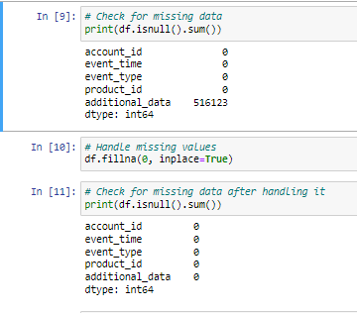
PROCEDURES FOLLOWED IN FIXING BAD DATA
Since the additional data column had missing values = 516123, which weren’t very peculiar to my aim of this analysis, I decided to eliminate the missing data in the additional data column.
Also, the 514 duplicate values were dropped from the dataset.
Following these operations, the data set consisted of 3,241,562 rows and 5 columns.
Extreme outliers weren’t observed in the record of events.
Furthermore, I converted the timestamps in the "event-time" feature to the ‘date-time’ data type. Then, I extracted the date and time information from the event-time column.

Slide 9
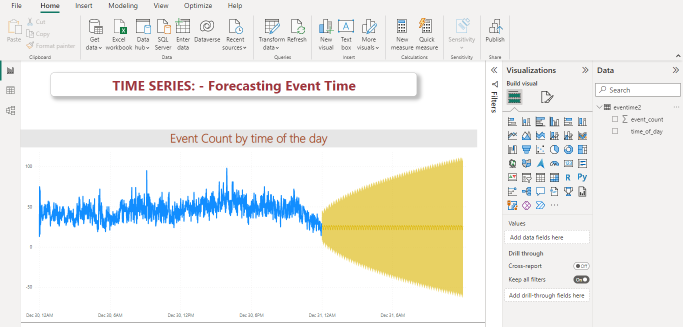
POWER BI Dashboard forecasting “event count” for times of the day for the next 24 hours.

